Slide 1
Chapter 4 Measures of Central Tendency

Slide 2
Measures of Central Tendency
Numbers that describe what is average or typical of the distribution

Slide 3
The Mode
The category or score with the largest frequency (percentage) in the distribution
Can be calculated for following variable levels:
Nominal
Ordinal
Interval-ratio

Slide 4
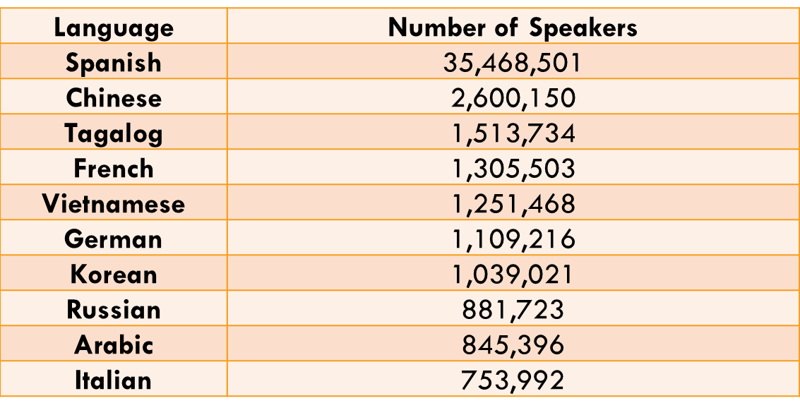
The Mode
Table 4.1 Ten Most Common Foreign Languages Spoken in the United States, 2009
MODE
Source: U.S. Census Bureau, The 2012 Statistical Abstract, Table 53.

Slide 5
Exercise: Mode of Class Level
What is the mode for class level in this class?
Freshmen
Sophomores
Juniors
Seniors (or greater)

Slide 6
The Median
The score that divides the distribution into two equal parts, so that half the cases are above it and half below it (the 50th percentile)
The middle score, or average of middle scores in a distribution

Slide 7
The Median: Odd Number of Cases
The number of hate crimes reported in the nine most populous U.S. states in 2014
Total (N) = 9
1,204
189
566
139
89
60
277
417
21
Arrange the number of hate crimes in order from the lowest to the highest: The middle case is (9 + 1)/2 = 5
The median of 189, divides the distribution exactly in half so that there are four states with fewer hate crimes and four with more

Slide 8
The Median: Even Number of Cases
The number of hate crimes reported in the nine most populous U.S. states in 2014
Total (N) = 8
2160
89
139
189
277
417
566
Find the two middle cases (8+1)/2=4.5
Median=139+189=164

Slide 9
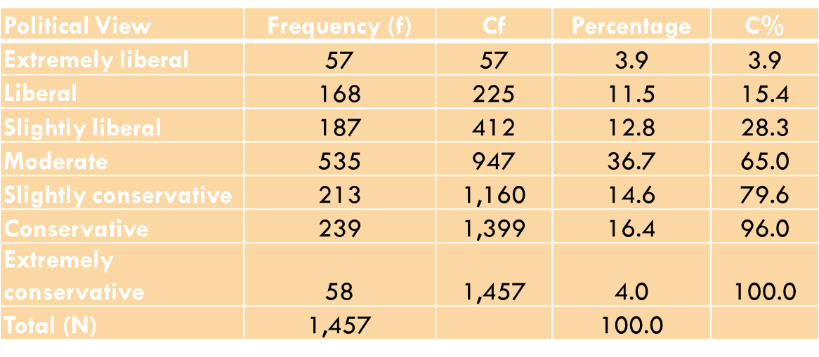
The Median: Frequency Distributions
(1,457+1)/2 = 729
Value of category associated with 729th case
Median

Slide 10
Percentiles
A score at or below which a specific percentage of the distribution falls
The nth percentile has n% of the cases fall below it
The 75th percentile has 75% of the cases are below it

Slide 11
The Mean
A measure obtained by adding up all the scores and dividing by the total number of scores
AKA the average
Can only be used for interval-ratio variables

Slide 12
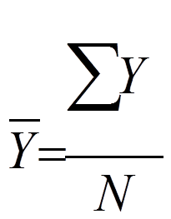
The Mean
Calculating the mean
Y = mean of Y
Y = the raw scores of the variable
ΣY = the sum of all the Y scores
N = the number of observations or cases

Slide 13
Exercise: Calculate Mean Number of Pets the Class Has
# of Pets

Slide 14
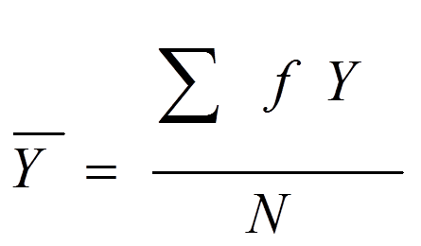
The Mean
Calculating the Mean in a Frequency Distribution
Y = the raw scores of the variable
Y = the mean of Y
ΣfY = the sum of all the fYs
N = the number of observations or cases

Slide 15
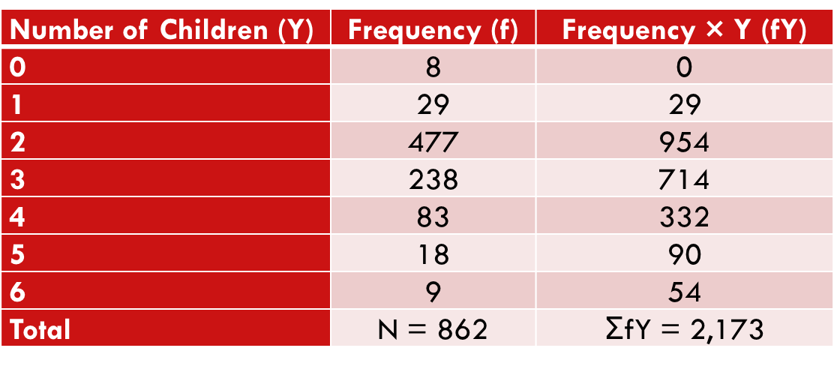
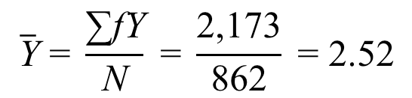
Example
Calculating the Mean Number of Children from a Frequency Distribution

Slide 16
Exercise: Mean Class Level (in Years) from a Frequency Distribution
Class Level (Y) | Frequency (f) | fY
1 (Freshman) | 1
2 (Sophomore) | 3
3 (Junior) | 8
4 (Senior +) | 8
Total | N = 20 | ΣfY =

Slide 17
The Mean
Important properties
Interval-ratio level of measurement
Center of gravity
Sensitivity to extremes

Slide 18
Shape of the Distribution
Symmetrical
Mean, median, and mode are similar
Skewed
Negatively (e.g. grades)
very few low values
Mean < median < mode
Positively (e.g. STDs)
very few high values
Mode < median < mean

Slide 19
Shape of the Distribution
Bimodal
Two distinct modes
Multi-modal
More than 2 distinct modes

Slide 20
Shape of the Distribution

Slide 21
Shape of the Distribution

Slide 22
Identifying Distribution Shape
In unimodal distributions, when the mode, the median, and the mean coincide or are almost identical, the distribution is symmetrical
If mean is higher than the median, the distribution is positively skewed
If mean is lower than the median, the distribution is negatively skewed

Slide 23
Measures of Central Tendency
Choosing a measure
Level of Measurement
Nominal
Mode
Ordinal
Mode or median
Interval-ratio
Symmetrical Distribution: Mode, median, or mean
Skewed Distribution: Mode or median

Slide 24
Key Terms
Mean
Measures of Central Tendency
Median
Mode
Negatively Skewed Distribution
Percentile
Positively Skewed Distribution
Skewed Distribution
Symmetrical Distribution

